Slide 1
Unit – 5
Memory Management

Slide 2
Logical vs. Physical Address Space
The concept of a logical address space that is bound to a separate physical address space is central to proper memory management
  Logical address – generated by the CPU; also referred to as virtual address
  Physical address – address seen by the memory unit
Logical and physical addresses are the same in compile-time and load-time address-binding schemes; logical (virtual) and physical addresses differ in execution-time address-binding scheme

Slide 3
Memory-Management Unit (MMU)
Hardware device that maps virtual to physical address
In MMU scheme, the value in the relocation register is added to every address generated by a user process at the time it is sent to memory
The user program deals with logical addresses; it never sees the real physical addresses

Slide 4

Dynamic relocation using a relocation register

Slide 5
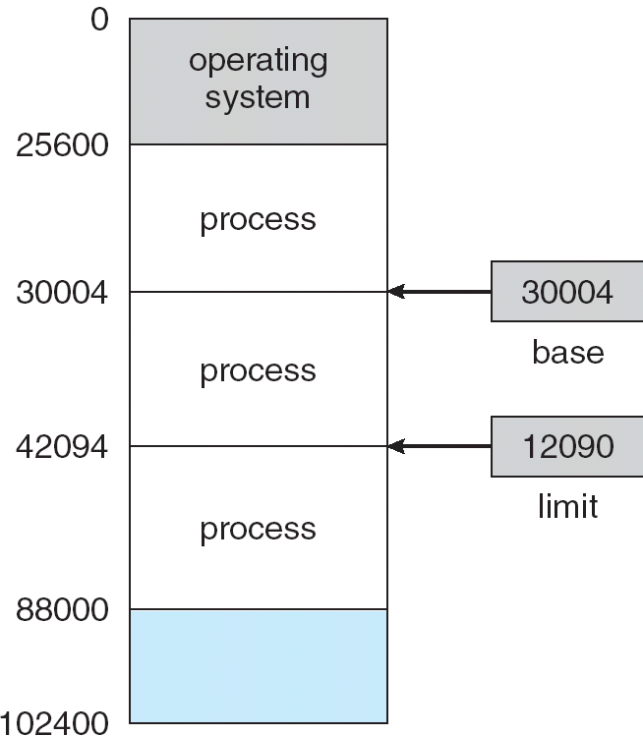
A base and a limit register define a logical address space

Slide 6

HW address protection with base and limit registers

Slide 7
Swapping
A process can be swapped temporarily out of memory to a backing store, and then brought back into memory for continued execution
Backing store – fast disk large enough to accommodate copies of all memory images for all users; must provide direct access to these memory images
Roll out, roll in – swapping variant used for priority-based scheduling algorithms; lower-priority process is swapped out so higher-priority process can be loaded and executed
Major part of swap time is transfer time; total transfer time is directly proportional to the amount of memory swapped
Modified versions of swapping are found on many systems (i.e., UNIX, Linux, and Windows)

Slide 8

Schematic View of Swapping

Slide 9
Contagious Memory Allocation
Contiguous memory allocation is basically a method in which a single contiguous section/part of memory is allocated to a process or file needing it. Because of this all the available memory space resides at the same place together, which means that the freely/unused available memory partitions are not distributed in a random fashion here and there across the whole memory space. The main memory is a combination of two main portions- one for the operating system and other for the user program. We can implement/achieve contiguous memory allocation by dividing the memory partitions into fixed size partitions.

Slide 10
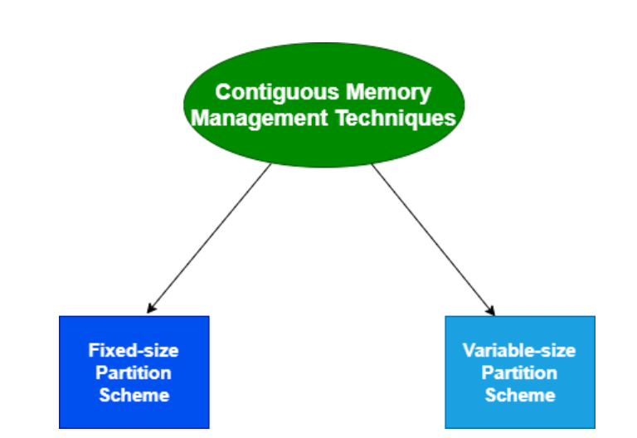
CONTAGIOUS MEMORY MANAGEMENT TECHNIQUES

Slide 11
FIXED SIZED PARTITION
Fixed-size Partition Scheme
This technique is also known as Static partitioning. In this scheme, the system divides the memory into fixed-size partitions. The partitions may or may not be the same size. The size of each partition is fixed as indicated by the name of the technique and it cannot be changed.
In this partition scheme, each partition may contain exactly one process. There is a problem that this technique will limit the degree of multiprogramming because the number of partitions will basically decide the number of processes.
Whenever any process terminates then the partition becomes available for another process.

Slide 12
Disadvantages of Fixed-size Partition Scheme
1. Internal Fragmentation
Suppose the size of the process is lesser than the size of the partition in that case some size of the partition gets wasted and remains unused. This wastage inside the memory is generally termed as Internal fragmentation
.
2. Limitation on the size of the process
If in a case size of a process is more than that of a maximum-sized partition then that process cannot be loaded into the memory.
3. External Fragmentation
It is another drawback of the fixed-size partition scheme as total unused space by various partitions cannot be used in order to load the processes even though there is the availability of space but it is not in the contiguous fashion.
4. Degree of multiprogramming is less

Slide 13
VARIABLE SIZE PARTITIONING
Dynamic partitioning tries to overcome the problems caused by fixed partitioning. In this technique, the partition size is not declared initially. It is declared at the time of process loading.
The first partition is reserved for the operating system. The remaining space is divided into parts. The size of each partition will be equal to the size of the process. The partition size varies according to the need of the process so that the internal fragmentation can be avoided.

Slide 14
FIRST FIT,BEST FIT AND WORST FIT
First Fit
In the first fit approach is to allocate the first free partition or hole large enough which can accommodate the process. It finishes after finding the first suitable free partition.
Best Fit
The best fit deals with allocating the smallest free partition which meets the requirement of the requesting process. This algorithm first searches the entire list of free partitions and considers the smallest hole that is adequate. It then tries to find a hole which is close to actual process size needed.
Worst fit
In worst fit approach is to locate largest available free portion so that the portion left will be big enough to be useful. It is the reverse of best fit.

Slide 15
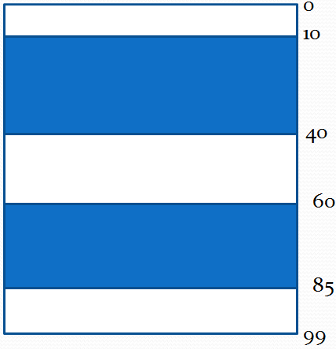
Memory Allocation - Example
  Given 3 free memory partitions of 10KB, 20 KB and 15KB ( in order) How would each of the first-fit, best- fit and worst fir algorithms place processes of 15KB, 10KB, 20KB and 5KB (in order)

Slide 16
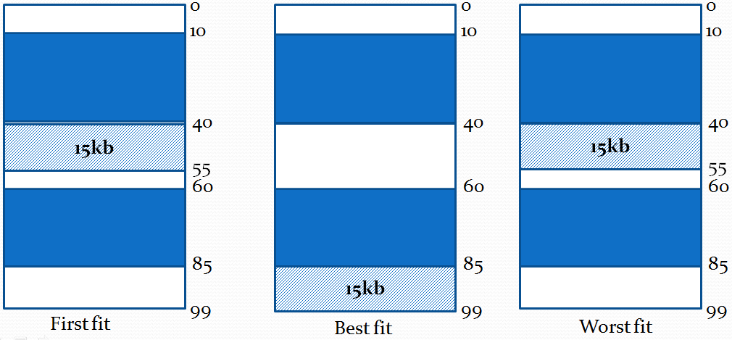

MEMORY ALLOCATION FOR 15 KB

Slide 17
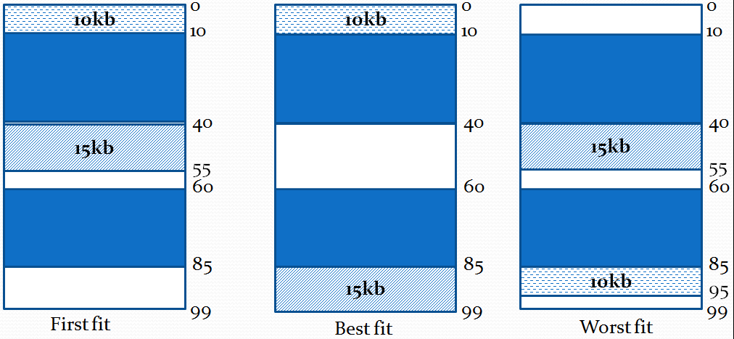
Memory Allocation - Example
  For 10KB

Slide 18
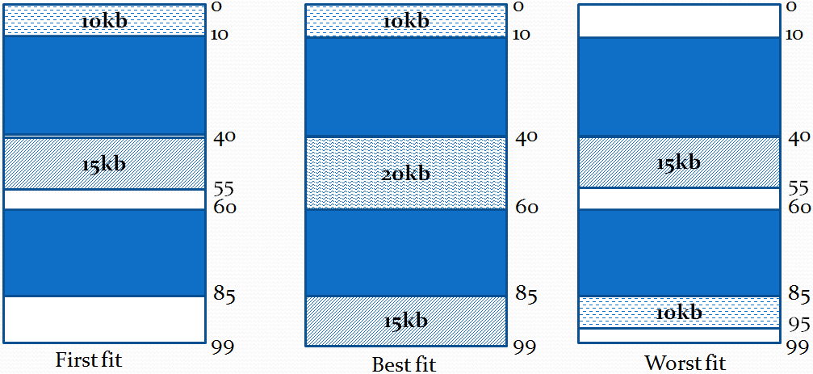
Memory Allocation - Example
  For 20KB

Slide 19
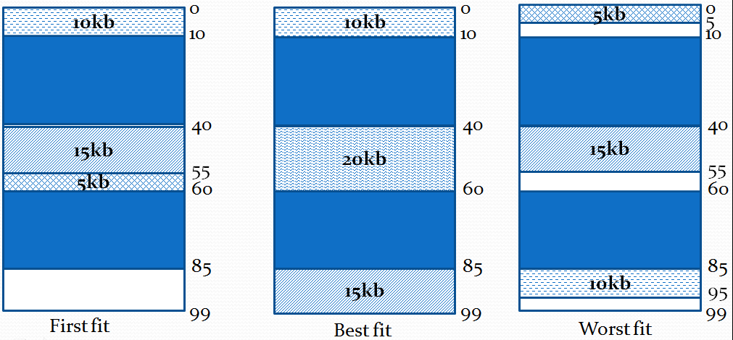
Memory Allocation - Example
  For 5KB

Slide 20
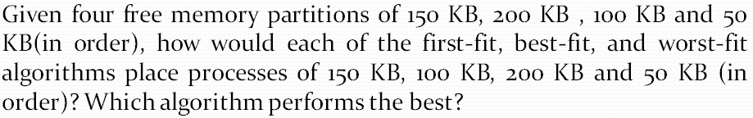
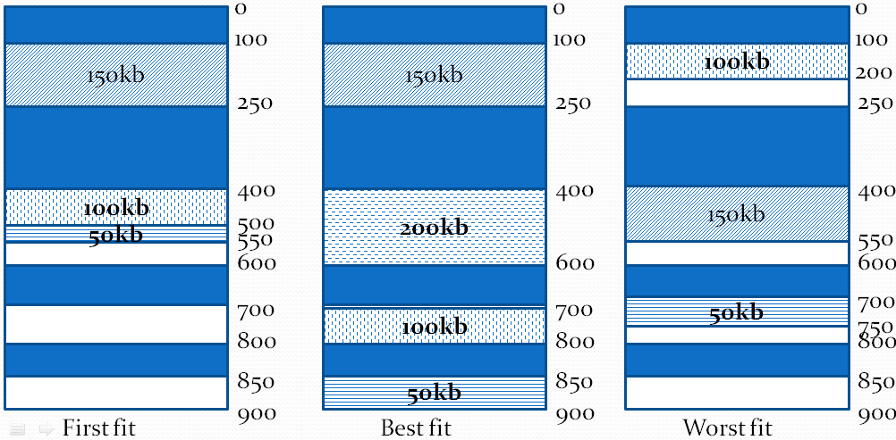

Slide 21
Advantages of Variable-size Partition Scheme
Some Advantages of using this partition scheme are as follows:
No Internal Fragmentation As in this partition scheme space in the main memory is allocated strictly according to the requirement of the process thus there is no chance of internal fragmentation. Degree of Multiprogramming is Dynamic more processes can be loaded into the memory at the same time.
No Limitation on the Size of Processprocess size.
Disadvantages of Variable-size Partition Scheme
Some Disadvantages of using this partition scheme are as follows:
External Fragmentation As there is no internal fragmentation which is an advantage of using this partition scheme does not mean there will no external fragmentation..
Difficult Implementation The implementation of this partition scheme is difficult as compared to the Fixed Partitioning scheme as it involves the allocation of memory at run-time rather than during the system configuration.

Slide 22
Fragmentation
External Fragmentation – total memory space exists to satisfy a request, but it is not contiguous
Internal Fragmentation – allocated memory may be slightly larger than requested memory; this size difference is memory internal to a partition, but not being used
Reduce external fragmentation by compaction
  Shuffle memory contents to place all free memory together in one large block

Slide 23
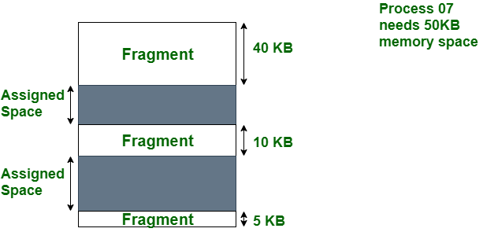
External Fragmentation

Slide 24
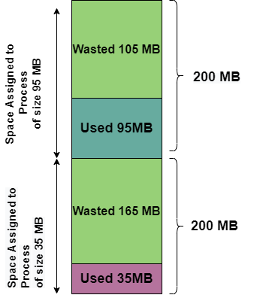
Internal Fragmentation

Slide 25
INTERNAL VS EXTERNAL FRAGMENTATION
Sr. No. | Internal Fragmentation | External Fragmentation
1. | Frames square measure designated for processing in internal fragmentation of fixed-sized storage. | Variable-sized memory frames square measure designated to the process during external fragmentation.
2. | When the system or procedure is greater than the storage, internal fragmentation occurs. | Whenever the system or procedure is withdrawn, external fragmentation occurs.
3. | The internal fragmentation approach is the frame with the perfect match. | Compression, paging, and differentiation are alternatives to external fragmentation.
4. | Internal fragmentation happens whenever the storage is split into fragments of a fixed length. | External fragmentation happens whenever the storage is split into segments of variable size depending on the process length.
5. | The distinction between the assigned memory and the storage or memory needed is considered as internal fragmentation. | The empty spaces created among non-contiguous pieces of storage are too tiny for a new system to operate, considered as external fragmentation.

Slide 26
NON CONTAGIOUS MEMORY ALLOCATION
Non-Contiguous memory allocation is basically a method on the contrary to contiguous allocation method, allocates the memory space present in different locations to the process as per it’s requirements. As all the available memory space is in a distributed pattern so the freely available memory space is also scattered here and there. This technique of memory allocation helps to reduce the wastage of memory, which eventually gives rise to Internal and external fragmentation.

Slide 27
NON-CONTAGIOUS MEMORY MANAGEMENT TECHNIQUES
Paging
Multilevel Paging
Inverted Paging
Segmentation

Slide 28
Paging
Logical address space of a process can be noncontiguous; process is allocated physical memory whenever the latter is available
Divide physical memory into fixed-sized blocks called frames (size is power of 2, between 512 bytes and 8192 bytes)
Divide logical memory into blocks of same size called pages.
Keep track of all free frames
To run a program of size n pages, need to find n free frames and load program
Set up a page table to translate logical to physical addresses
Internal fragmentation

Slide 29
Address Translation Scheme
Address generated by CPU is divided into:
  Page number (p) – used as an index into a page table which contains base address of each page in physical memory
  Page offset (d) – combined with base address to define the physical memory address that is sent to the memory unit

Slide 30
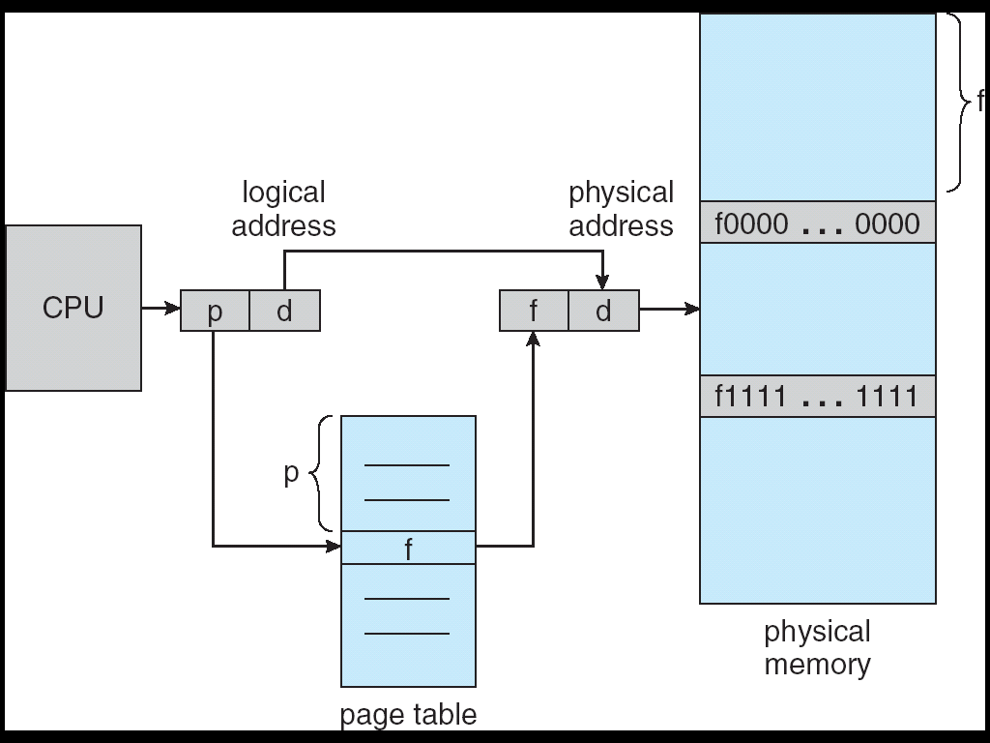
Address Translation Architecture

Slide 31
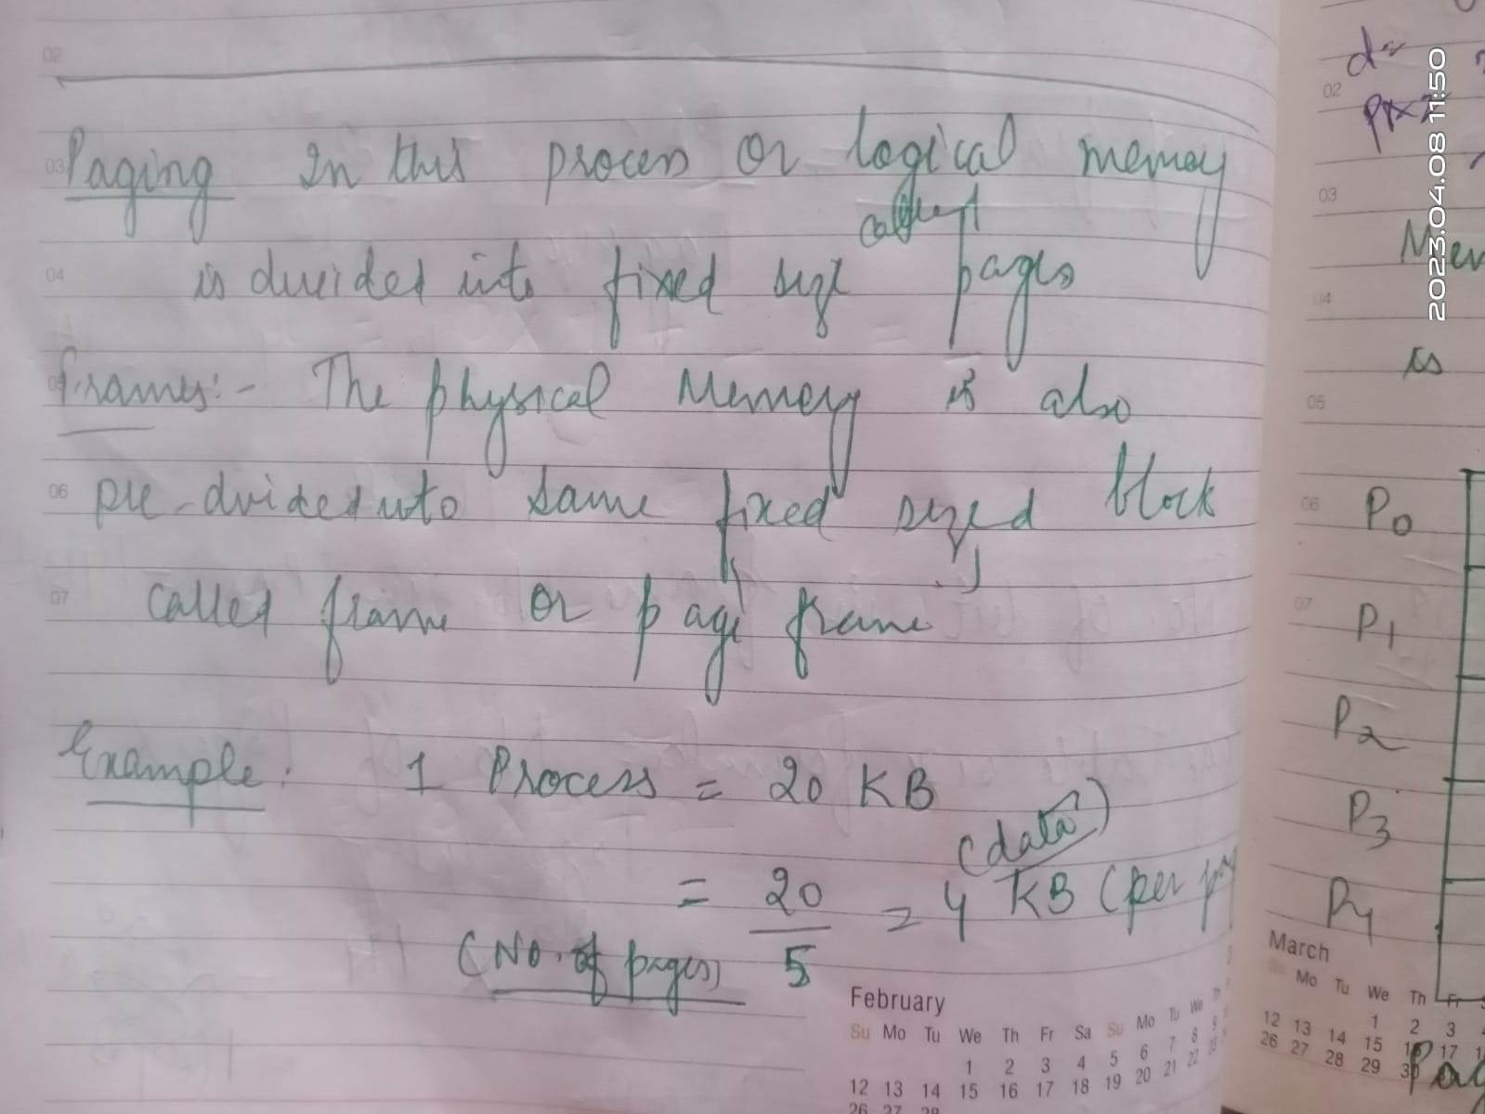
PAGING

Slide 32
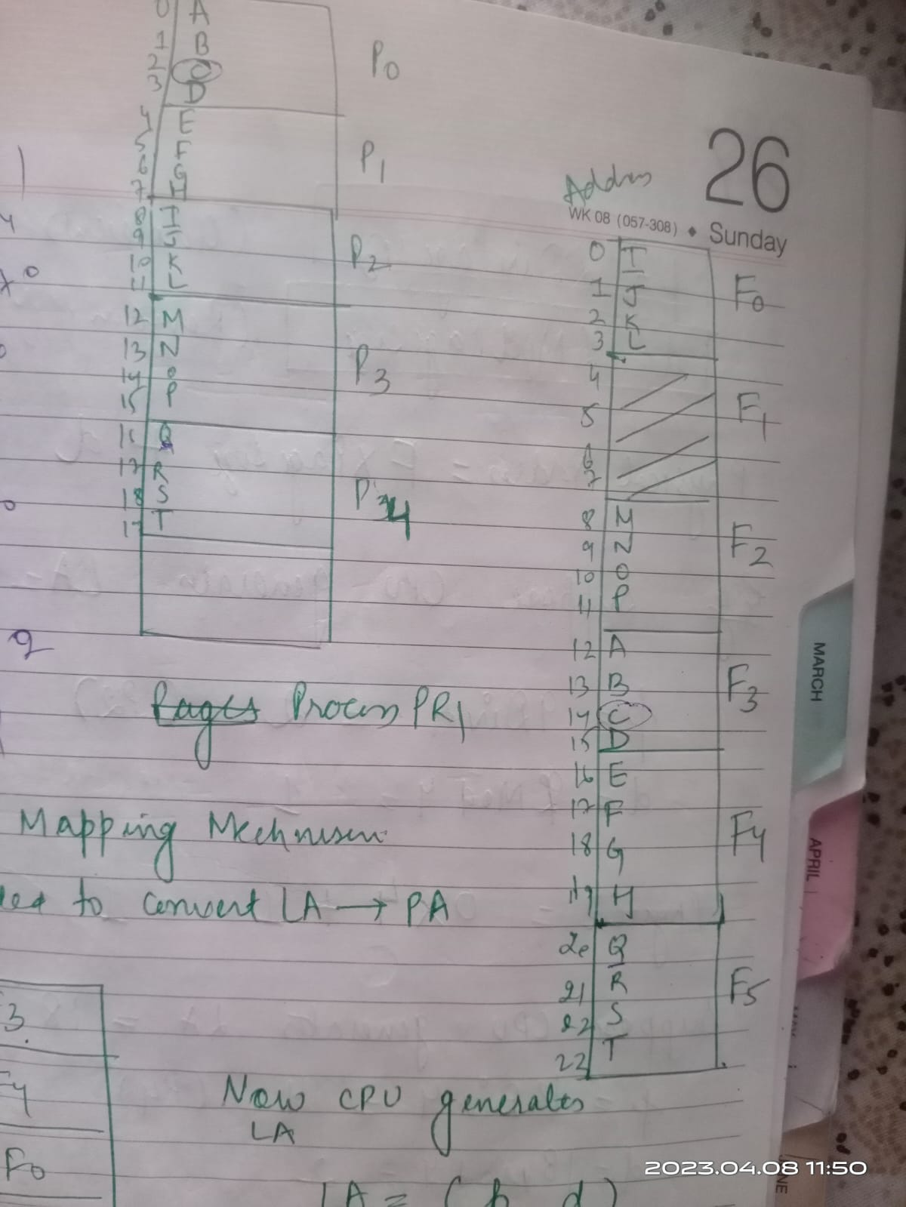
PAGING EXAMPLE CONTD.

Slide 33
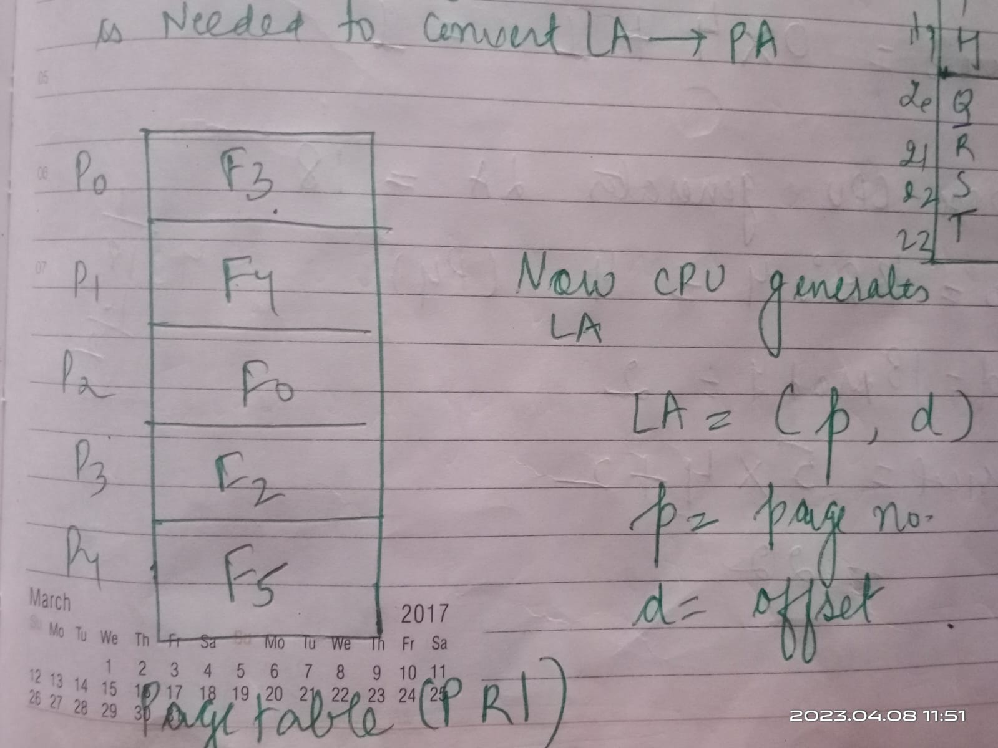
NEED TO CONVERT LOGICAL ADDRESS TO PHYSICAL ADDRESS

Slide 34
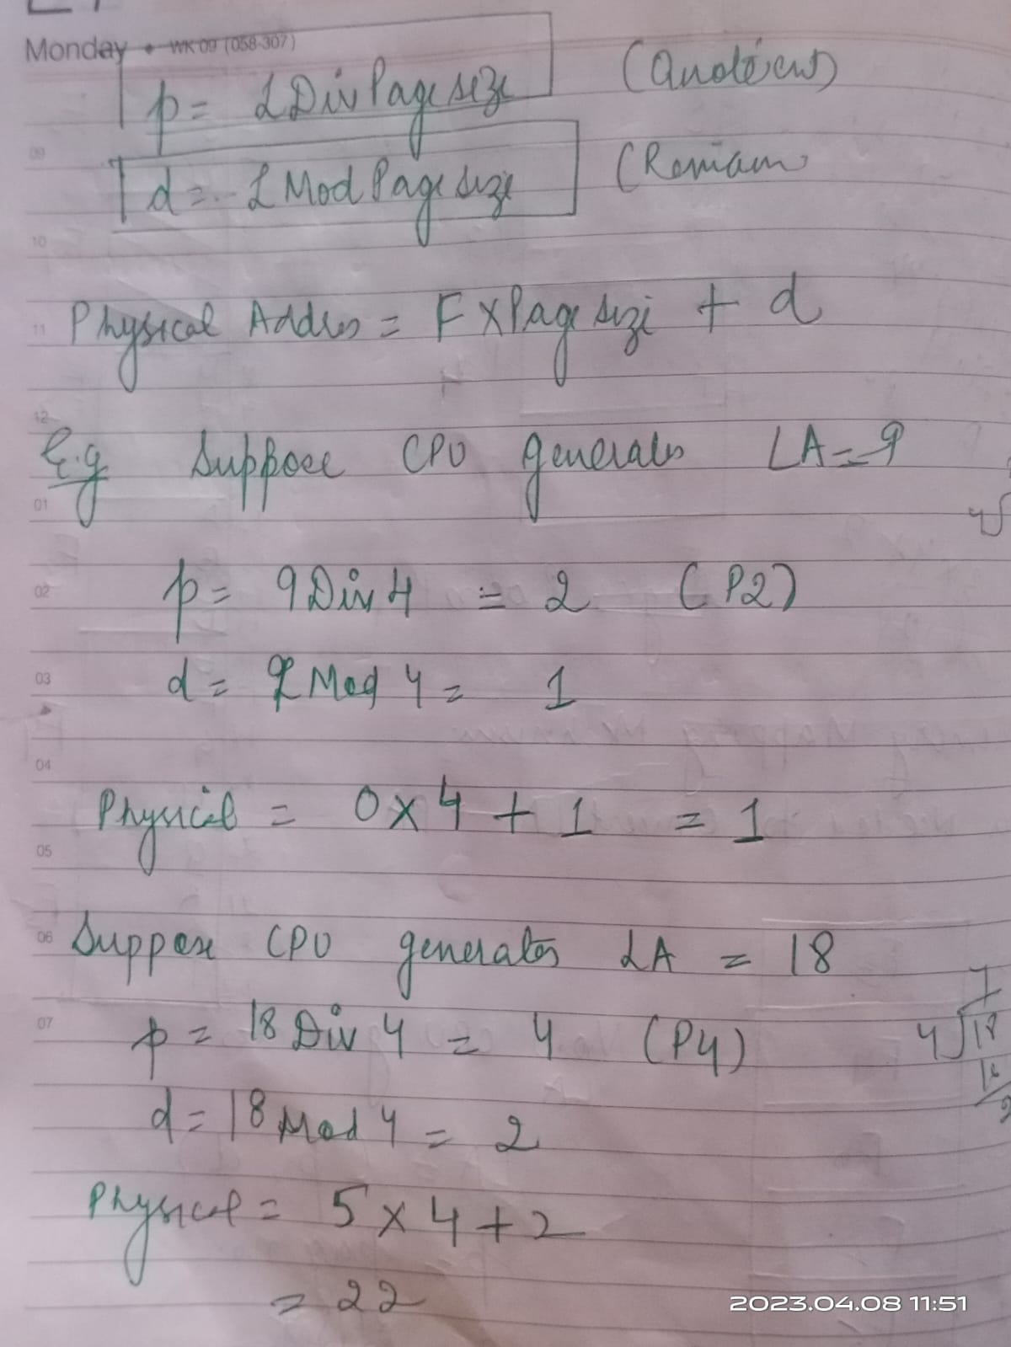
FORMULAS FOR CALCULATING page number(p),offset(d) and corresponding physical address

Slide 35
MULTILEVEL PAGING
In multilevel paging,the page table having size greater than the frame size is divided into several parts.
The size of each part is same as frame size except possibly the last part.
The pages of page table are then stored in different frames of the main memory.
To keep track of the frames storing the pages of the divided page table, another page table is maintained.
As a result, the hierarchy of page tables get generated.
Multilevel paging is done till the level is reached where the entire page table can be stored in a single frame.

Slide 36
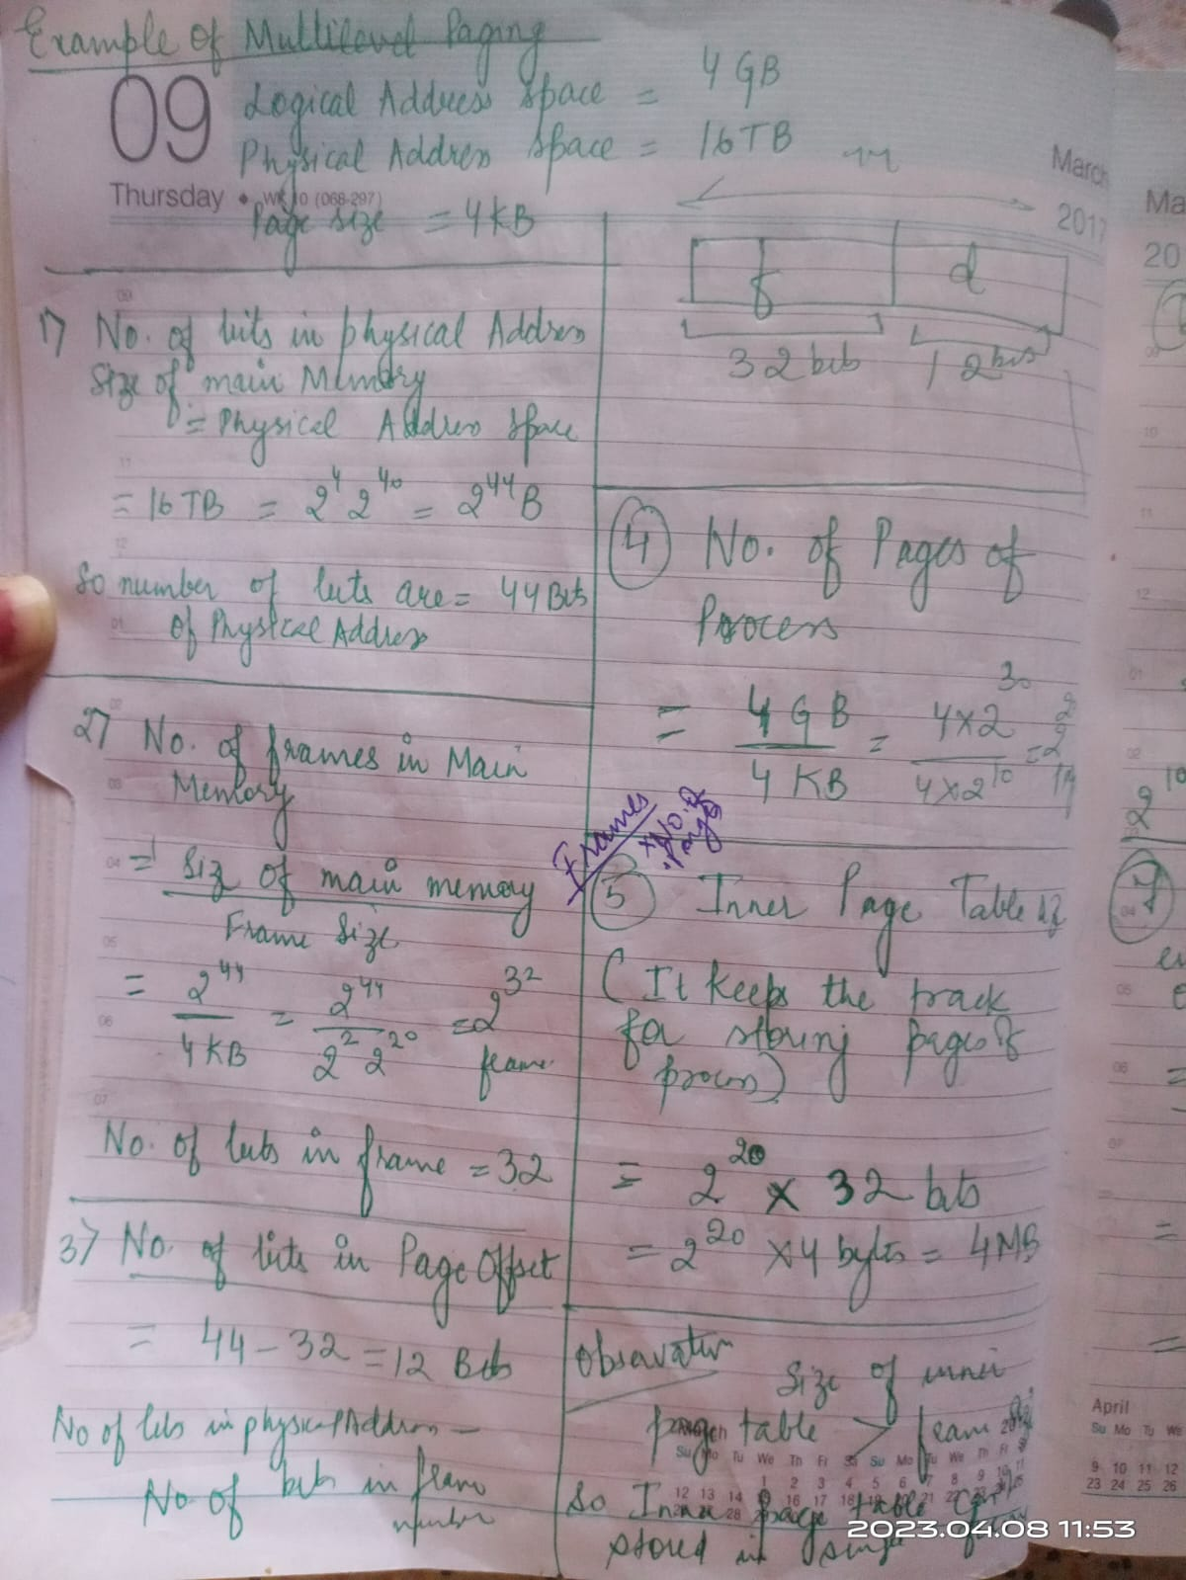
Example of multilevel paging

Slide 37
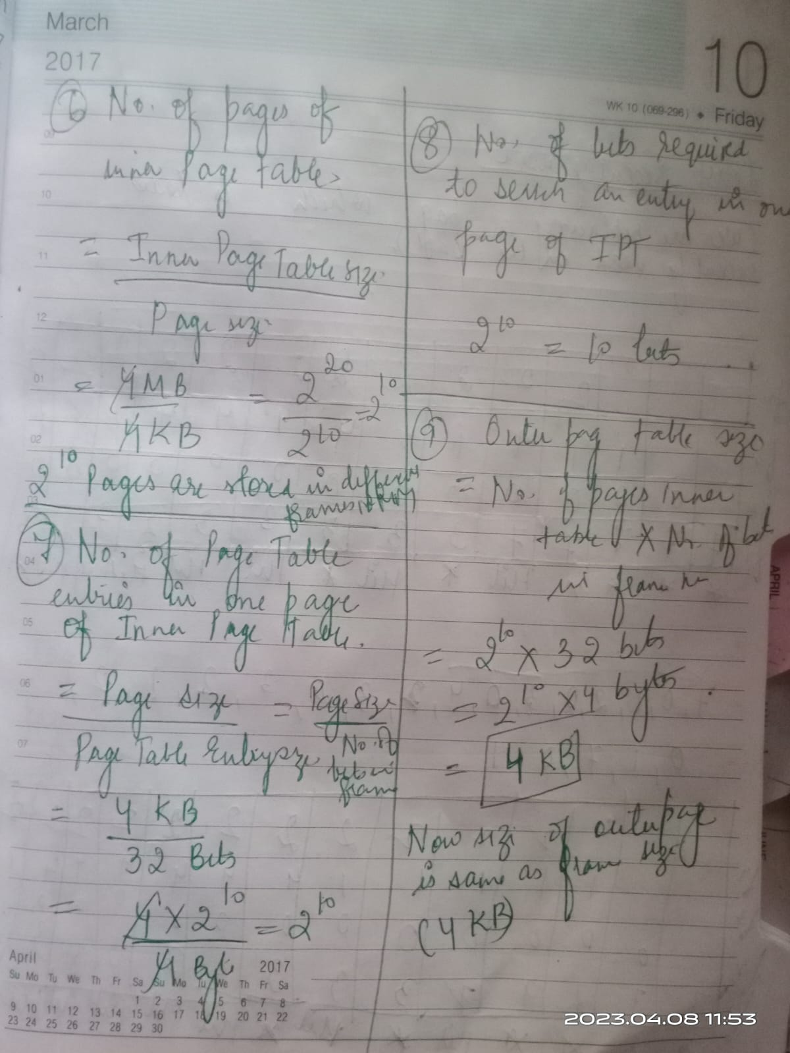
MULTILEVEL PAGING EXAMPLE CONTD.

Slide 38
Implementation of Page Table
Page table is kept in main memory
Page-table base register (PTBR) points to the page table
Page-table length register indicates size of the page table
In this scheme every data/instruction access requires two memory accesses. One for the page table and one for the data/instruction.
The two memory access problem can be solved by the use of a special fast-lookup hardware cache called associative memory or translation look-aside buffers (TLBs)

Slide 39
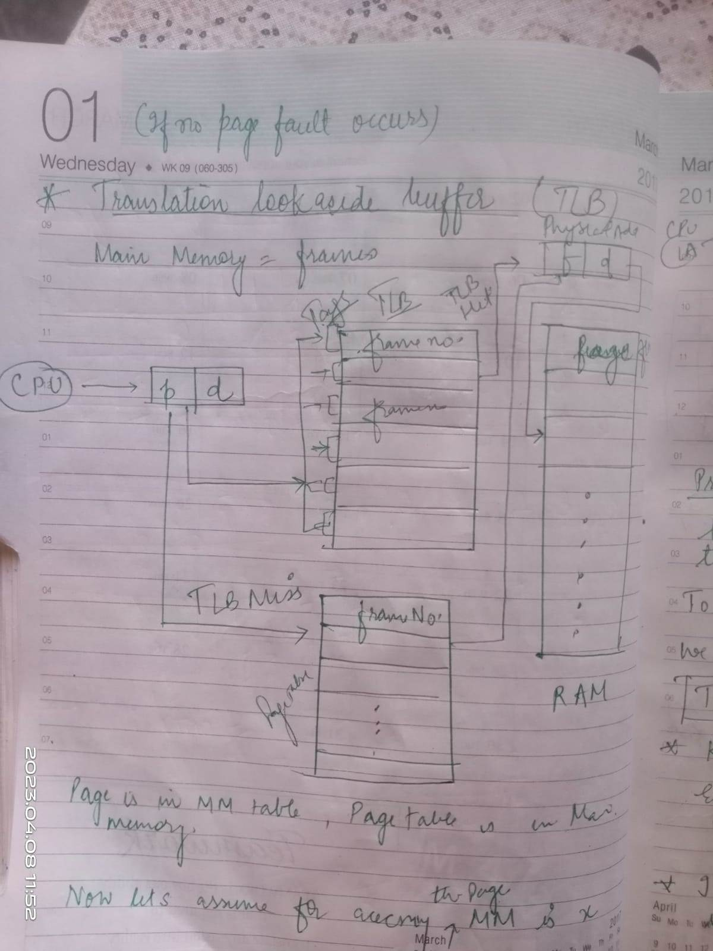
TRANSLATION LOOK ASIDE BUFFER

Slide 40
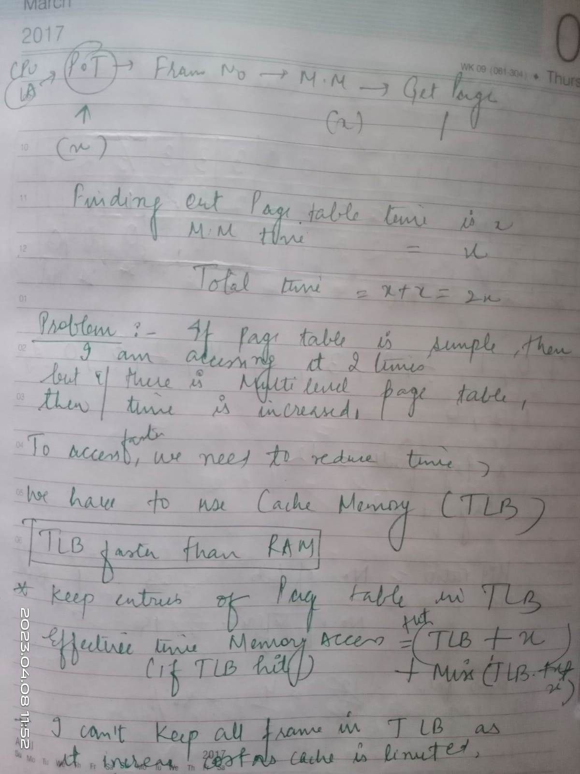
TLB Contd.

Slide 41

Paging Hardware With TLB

Slide 42
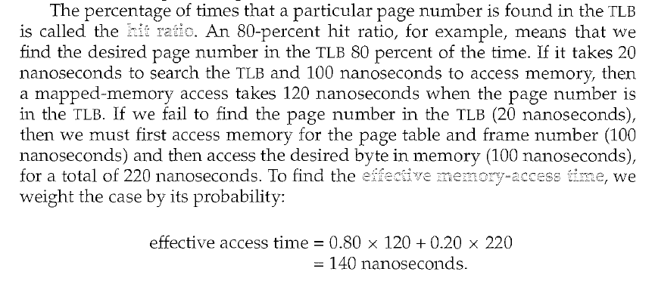
TRANSLATION LOOK ASIDE BUFFER

Slide 43
Effective Access Time
Associative Lookup = ε time unit
Assume memory cycle time is 1 microsecond
Hit ratio – percentage of times that a page number is found in the associative registers; ration related to number of associative registers
Hit ratio = α
Effective Access Time (EAT)
EAT = (1 + ε) α + (2 + ε)(1 – α)
= 2 + ε – α

Slide 44
Memory Protection
Memory protection implemented by associating protection bit with each frame
Valid-invalid bit attached to each entry in the page table:
  “valid” indicates that the associated page is in the process’ logical address space, and is thus a legal page
  “invalid” indicates that the page is not in the process’ logical address space

Slide 45

Valid (v) or Invalid (i) Bit In A Page Table

Slide 46
Inverted Page Table
One entry for each real page of memory
Entry consists of the virtual address of the page stored in that real memory location, with information about the process that owns that page
Decreases memory needed to store each page table, but increases time needed to search the table when a page reference occurs
Use hash table to limit the search to one — or at most a few — page-table entries

Slide 47

Inverted Page Table Architecture

Slide 48
Shared Pages
Shared code
  One copy of read-only (reentrant) code shared among processes (i.e., text editors, compilers, window systems).
  Shared code must appear in same location in the logical address space of all processes
Private code and data
  Each process keeps a separate copy of the code and data
  The pages for the private code and data can appear anywhere in the logical address space

Slide 49
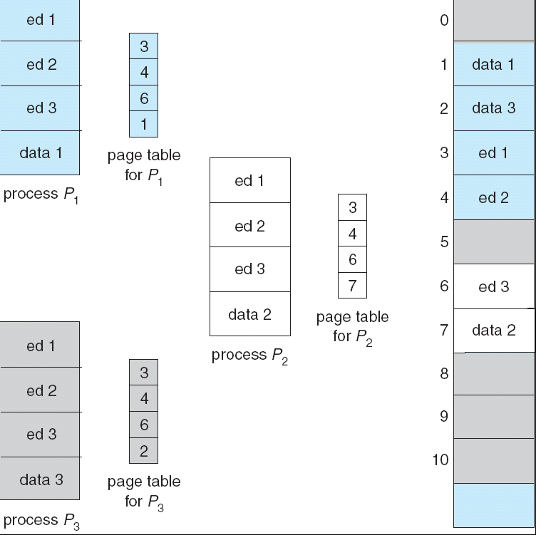
Shared Pages Example

Slide 50
Segmentation
Memory-management scheme that supports user view of memory
A program is a collection of segments. A segment is a logical unit such as:
main program,
procedure,
function,
method,
object,
local variables, global variables,
common block,
stack,
symbol table, arrays

Slide 51

User’s View of a Program

Slide 52
Logical View of Segmentation
1
1
4
2
3
4
2
3
user space
physical memory space

Slide 53
Segmentation Architecture
Logical address consists of a two tuple:
<segment-number, offset>,
Segment table – maps two-dimensional physical addresses; each table entry has:
  base – contains the starting physical address where the segments reside in memory
  limit – specifies the length of the segment
Segment-table base register (STBR) points to the segment table’s location in memory
Segment-table length register (STLR) indicates number of segments used by a program;
segment number s is legal if s < STLR

Slide 54
So what is segmentation ?
In Operating Systems, Segmentation is a memory management technique in which the memory is divided into the variable size parts. Each part is known as a segment which can be allocated to a process.
The details about each segment are stored in a table called a segment table. Segment table is stored in one (or many) of the segments.
Segment table contains mainly two information about segment:
Base: It is the base address of the segment
Limit: It is the length of the segment.

Slide 55

Address Translation Architecture in segmentation

Slide 56

Example of Segmentation

Slide 57
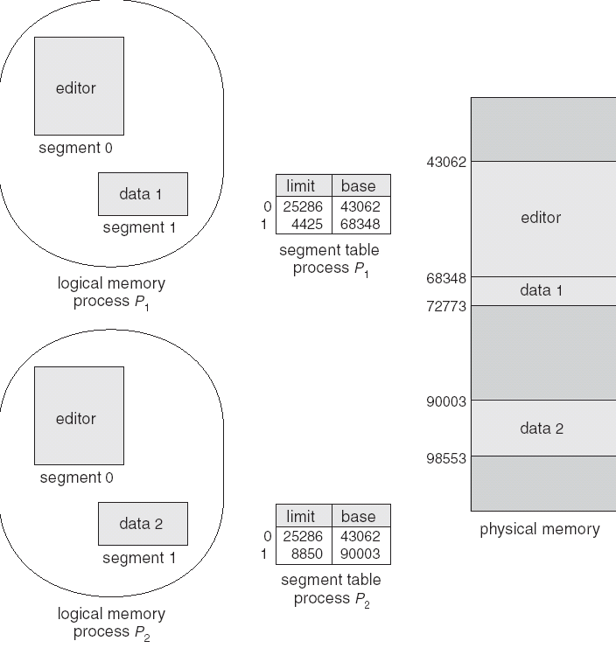
Sharing of Segments

Slide 58
Advantages of segmentation no internal fragmentation average segment size is larger than the actual page size.
Less overhead it is easier to relocate segments than entire address space.
The segment table is of lesser size as compared to the page table in paging.
Disadvantages it can have external fragmentation.
It is difficult to allocate contiguous memory to variable sized partition.
Costly memory management algorithms.

Slide 59
Page Fault
In operating systems, a page fault is an exception/error that is raised by the memory management unit if a process accesses a memory page without it being loaded into the memory. A mapping is required to be added to the virtual address space of the process to access the page. The page contents are loaded from a backing store (secondary storage), such as a disk. The page fault is detected by the memory management unit, but the operating system's kernel handles the exception by making the required page accessible in the physical memory or denying illegal memory access.

Slide 60
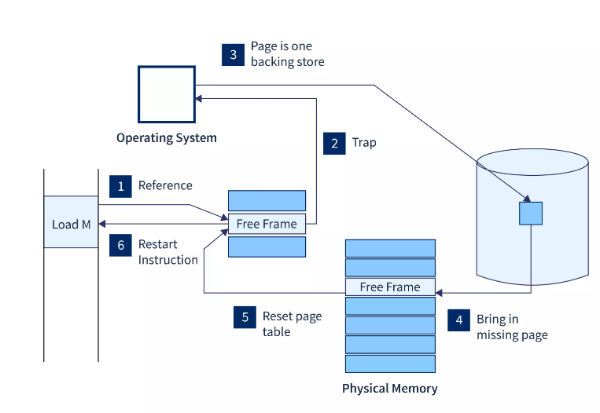
Page Fault diagram

Slide 61
PAGE FAULT
At first, an internal table is created to process whether the reference was valid or invalid memory access.
The system gets terminated if the reference becomes invalid, if not, the page will be paged in.
After checking for validity, the free-frame list searches the system for a free frame.
The disk operation will be scheduled to get the required page from the disk.
The page table of the process will be updated with a new frame number, and the invalid bit will be changed after the completion of the I/O operation. Now it is a valid page reference.
Restart these steps upon finding any more page faults.

Slide 62
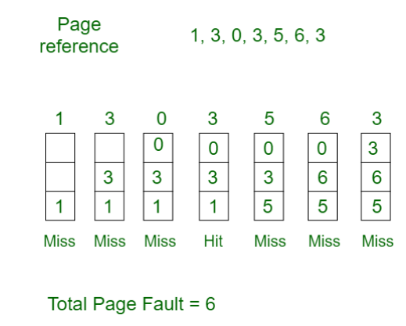
PAGE REPLACEMENT ALGORITHMS
Page Replacement Algorithms:
1. First In First Out (FIFO): This is the simplest page replacement algorithm. In this algorithm, the operating system keeps track of all pages in the memory in a queue, the oldest page is in the front of the queue. When a page needs to be replaced page in the front of the queue is selected for removal.
Example 1: Consider page reference string 1, 3, 0, 3, 5, 6, 3 with 3 page frames.Find the number of page faults.

Slide 63
Calculate total page fault, total page hit, then percentage of page hit ratio

Slide 64
Belady’s Anomaly
Belady’s Anomaly in FIFO –
Assuming a system that has no pages loaded in the memory and uses the FIFO Page replacement algorithm. Consider the following reference string:
1, 2, 3, 4, 1, 2, 5, 1, 2, 3, 4, 5
Case-1: If the system has 3 frames, the given reference string the using FIFO page replacement algorithm yields a total of 9 page faults. The diagram below illustrates the pattern of the page faults occurring in the example.

Slide 65
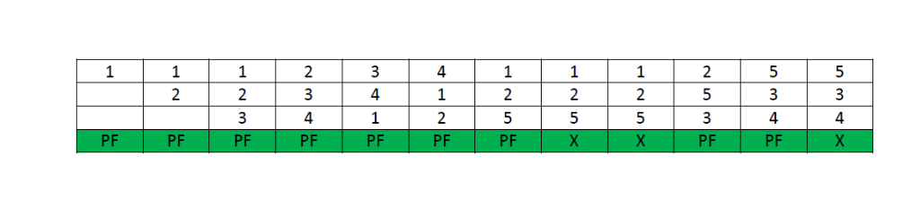
When the frame size is 3

Slide 66
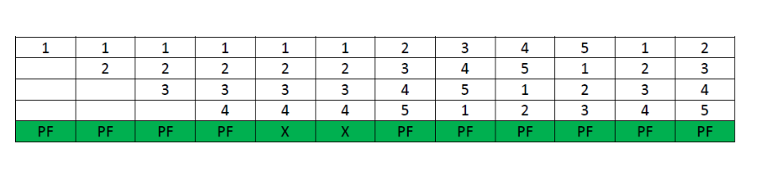
Case-2: If the system has 4 frames, the given reference string using the FIFO page replacement algorithm yields a total of 10 page faults. The diagram illustrates the pattern of the page faults occurring in the example.

Slide 67
It can be seen from the above example that on increasing the number of frames while using the FIFO page replacement algorithm, the number of page faults increased from 9 to 10.

Slide 68
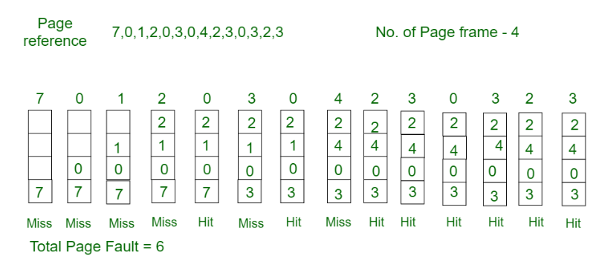
Consider the page reference string 7, 0, 1, 2, 0, 3, 0, 4, 2, 3, 0, 3, 2, 3 with 4 page frames. Find number of page faults in least recently used.

Slide 69
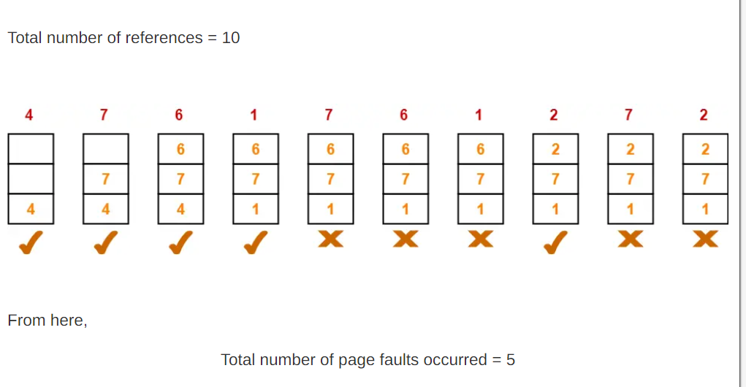
Optimal Page replacement
A system uses 3 page frames for storing process pages in main memory. It uses the Optimal page replacement policy. Assume that all the page frames are initially empty. What is the total number of page faults that will occur while processing the page reference string given below-
4 , 7, 6, 1, 7, 6, 1, 2, 7, 2

Slide 70
Optimal Page Replacement Contd.
In the similar manner as above-
Hit ratio = 0.5 or 50%
Miss ratio = 0.5 or 50%

Slide 71
What is Thrashing
thrashing occurs when a computer's virtual memory resources are overused, leading to a constant state of paging and page faults, inhibiting most application-level processing. It causes the performance of the computer to degrade or collapse. The situation can continue indefinitely until the user closes some running applications or the active processes free up additional virtual memory resources.
Thrashing is when the page fault and swapping happens very frequently at a higher rate, and then the operating system has to spend more time swapping these pages. This state in the operating system is known as thrashing. Because of thrashing, the CPU utilization is going to be reduced or negligible.

Slide 72
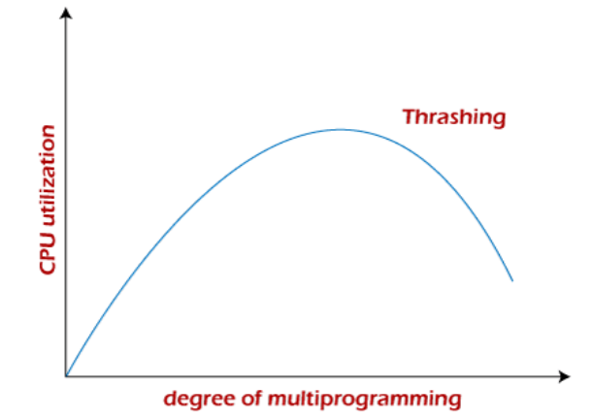
THRASHING

Slide 73
Overlays
The main problem in Fixed partitioning is the size of a process has to be limited by the maximum size of the partition, which means a process can never be span over another.In order to solve this problem, earlier people have used some solution which is called as Overlays.
The concept of overlays is that whenever a process is running it will not use the complete program at the same time, it will use only some part of it. Then overlays concept says that whatever part you required, you load it and once the part is done, then you just unload it, means just pull it back and get the new part you required and run it.

Slide 74
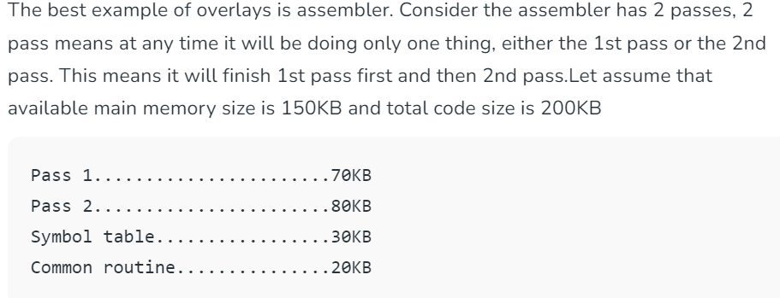
Overlays Example

Slide 75
Overlays Contd.
As the total code size is 200KB and main memory size is 150KB, it is not possible to use 2 passes together.So, in this case, we should go with the overlays technique.According to the overlays concept at any time only one pass will be used and both the passes always need symbol table and common routine.Now the question is if overlays-driver* is 10KB, then what is the minimum partition size required?For pass 1 total memory needed is = (70KB + 30KB + 20KB + 10KB) = 130KB and for pass 2 total memory needed is = (80KB + 30KB + 20KB + 10KB) = 140KB.So if we have minimum 140KB size partition then we can run this code very easily.

Slide 76
THANK YOU

